Slide 1


Page and page extensions

Slide 2
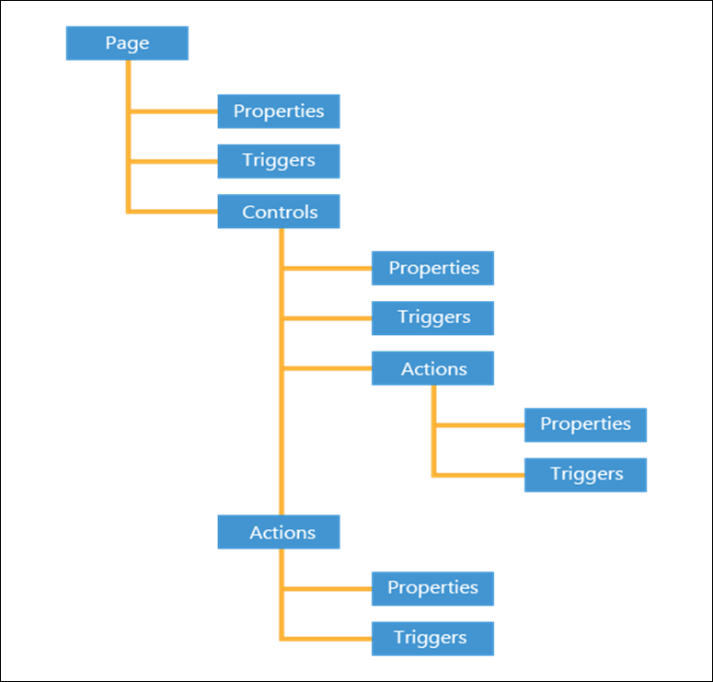
Module Agenda
Identify the different page types.
Discover the different page properties.
Learn how to build the layout of new pages.
Link pages with page parts.
Use snippets to create pages in Visual Studio Code.
Enable end users to search for a page.
Define actions on a page and set its properties.
Learn how to create a new page extension.
Discover the possibilities and limitations of a page extension.
Learn about the difference in properties of a page extension and a page.
Use the Page Designer to change the layout of a page.

Slide 3
Different Page Types
Card – Customer Card, Vendor Card, Item Card
List – Customer list, Vendor List, Item List
CardPart – Fact Boxes
ListPart – Line FastTabs on document pages
HeadlinePart – Headline on role centers
Document – Sales Order, Sales Invoice, Purchase Order
RoleCenter – Business Manager Role Center, Administrator Role Center
Worksheet – Journals pages
ConfirmationDialog – Yes/No dialog pages
StandardDialog – Ok/Cancel, Previous/Next dialog pages
ListPlus - Statistics, details, and related data management
Navigate – Assisted Setups
API – Pages to used for interfacing with external systems
Notes:
In Business Central, you can develop different types of pages, which are indicated in the layout of each page.
You can distinguish the following page types:
Card – Customer Card, Vendor Card, Item Card
List – Customer list, Vendor List, Item List
CardPart – Fact Boxes
ListPart – Line FastTabs on document pages
HeadlinePart – Headline on role centers
Document – Sales Order, Sales Invoice, Purchase Order
RoleCenter – Business Manager Role Center, Administrator Role Center
Worksheet – Journals pages
ConfirmationDialog – Yes/No dialog pages
StandardDialog – Ok/Cancel, Previous/Next dialog pages
ListPlus - Statistics, details, and related data management
Navigate – Assisted Setups
API – Pages to used for interfacing with external systems
Pages of the type API are used to create versioned, webhook-supported, OData v4 enabled REST web services. This type of page cannot be displayed in the user interface, but is intended for building reliable integration services. When creating this page type, you must specify a number of properties that provide information for the web service endpoint.
Demo –Different type of pages

Slide 4
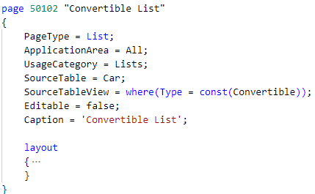
The Different Page Properties
ID and Name properties
Caption property
PageType property
CardPageId property
SourceTable and SourceTableView properties
Editable property
InsertAllowed, ModifyAllowed, and DeleteAllowed properties
Notes:
When you create a new page, you must configure certain parameters called page properties.
ID and Name properties
Like every object in Business Central, a page also has an ID and Name property. The ID is a number that must be in the number range that you receive from Microsoft when you become a Dynamics 365 Business Central partner. This approach ensures that no objects will have the same ID in your Business Central database.
Along with an ID, you must also give your page a name so you will have the ability to use the Name property. Depending on the type of page, you should always follow the same structure when naming a page. For example, if you have a Card page, you will use Customer Card and you would use Customer List for a List page. The name of the page should also be unique.
Caption property
The Caption property is the text that is displayed in the title bar of your window.
PageType property
The PageType property is a property on the page level that defines the layout of your window. Correspondingly, a page of PageType Card will result in a different layout and actions than a page of PageType List.
CardPageId property
The CardPageId property is also a page property that is used for list pages. This property indicates the page that should be displayed when a user selects a record in a list. As a result, the system will display a page of type Card, which shows details of the selected item. When you create a page, you can specify the CardPageId by using the name of the Card page.
SourceTable and SourceTableView properties
Two other important page properties are SourceTable and SourceTableView. The SourceTable property is used to define the table for which the page will display records. A Card page will only display one record, while a List page will display multiple records. A page can only display information from one table.
The SourceTableView will allow you to sort and filter the SourceTable records that are displayed. If you want to create a page that only displays cars of type Convertible, you can create this page by using the SourceTableView property.
Editable property
The Editable property is used to define whether users can make changes to records by using this page or not. By default, the Editable property is set to Yes. If this property is set to No, but the Editable property on the Control level (which will be discussed later) is set to Yes, it still won't be possible to change the data. Therefore, the page's Editable property overrules the property on the control. On the List page, the Editable property is set to No because you don't want to be able to change data by using a list.
InsertAllowed, ModifyAllowed, and DeleteAllowed properties
If you want your users to be able to modify data, but not insert or delete new data, you can use the InsertAllowed, ModifyAllowed, and DeleteAllowed properties. A typical example is a setup page in Business Central.
In a setup table, you only allow one record; thus, you don't want your users to be able to insert new records or delete the existing record. Therefore, you should set InsertAllowed and DeleteAllowed to No, and ModifyAllowed to Yes because you want your users to be able to change the setup data. The default value for these properties is Yes.

Slide 5
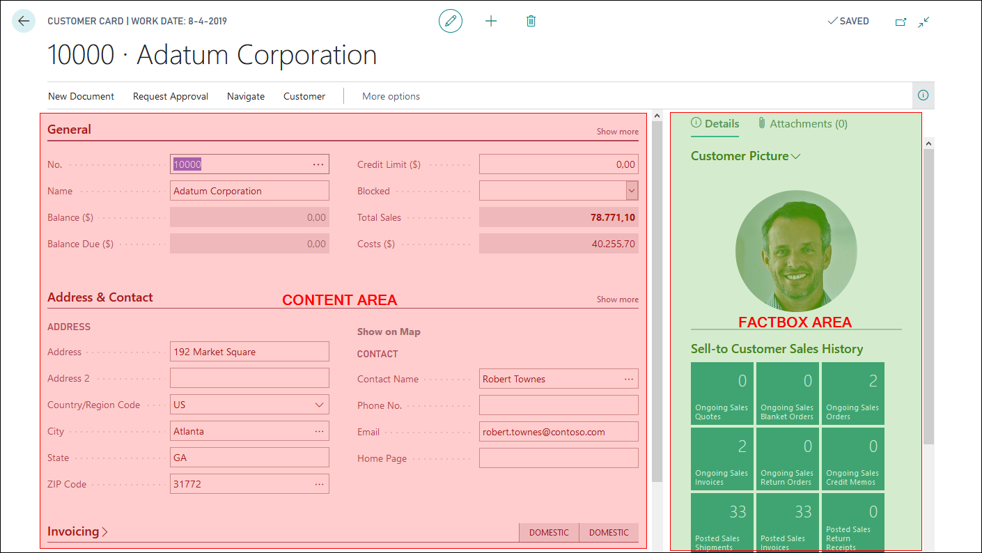
Page Layout

Slide 6
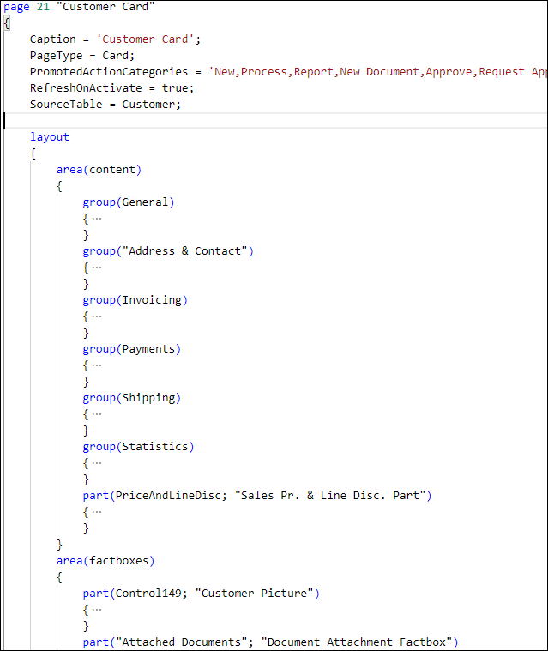
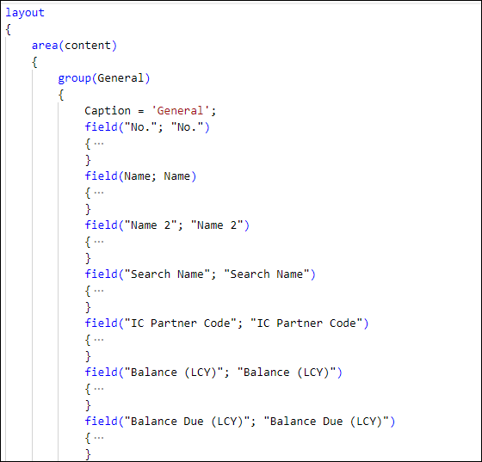
Adding Fields on a Card Page
Notes:
Before you can add fields on a page, you must first define your layout structure. A Card page is built with several FastTabs, which are groups of fields that are displayed in bold. You can collapse or expand these FastTabs.
The Customer Card contains the General, Address & Contact, Invoicing, Payments, Shipping, and Statistics FastTabs.
To create FastTabs, you need to define them in AL as groups, as shown in the following image.
Then, within a group, you can enter the necessary fields and the caption of the group.

Slide 7
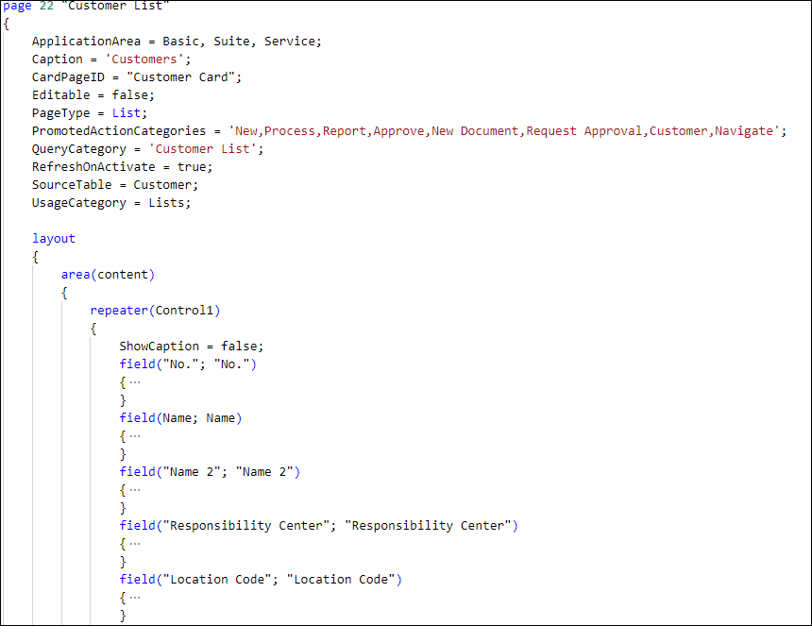
Adding Fields on a List Page

Slide 8
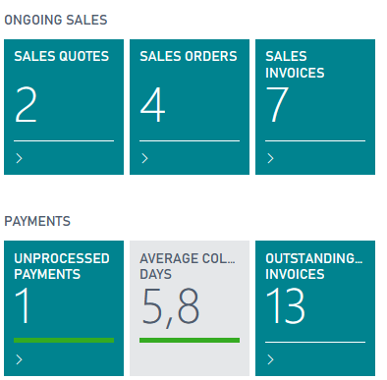
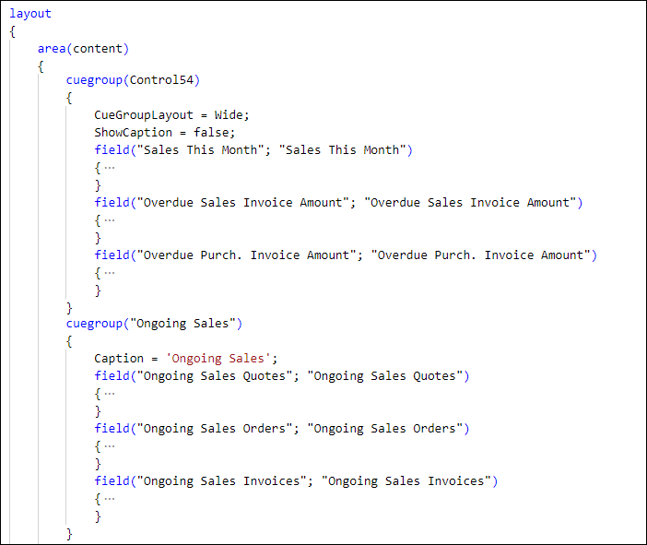
Adding Cue Groups
Notes:
Cues and cue groups are typically used in Role Centers. They emphasize the important information for users in specific roles and are therefore a key part in role tailoring. Cues are used to visually provide a way to show the number of entities in a table and view the entities in a filtered list.
A cue can show the total number of contacts or the total number of open opportunities. For example, it can display all invoices due or sales orders that were delayed.
When you create a page, you can group cue fields inside a cue group. In the preceding example, Ongoing Sales, Ongoing Purchases, My User Tasks, Approvals, Payments, and Incoming Documents are all cue groups.
Within a cue group are the cue group fields such as Sales Quotes, Purchase Orders, or Unprocessed Payments.
In AL, you can define these cue groups by using the keyword cuegroup instead of a regular group. The CueGroupLayout property can be set to Wide to display larger amounts, such as the Overdue Sales Invoice Amount from the previous example.

Slide 9
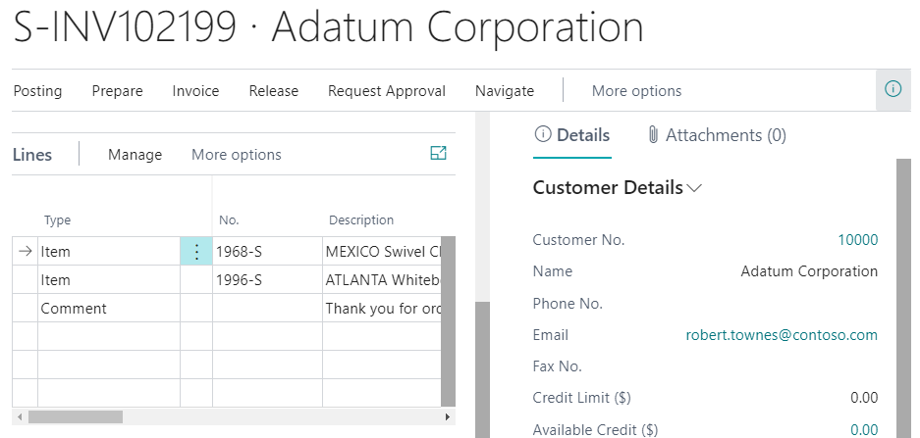
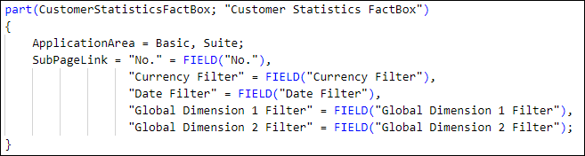
Link Pages with Page Parts
Notes:
Page parts are used on FactBoxes and document pages for displaying extra information about the current selected record. For example, on a customer card, you can display the latest purchases in a FactBox or display them as a part of the total number of unpaid invoices.
On a document page, page parts are typically used for displaying the lines. On a sales document, the Document page is linked to the Sales Header table and a page part, which displays all invoice lines from the Sales Lines table.
To define a part on a page, use the tpart snippet. A part has the following structure:
part(PartName; PartSource)
Your first task is to define the name of the control on the page. Next, provide the name of the page that should be loaded in the page part. The page name is the name of a ListPart or CardPart, as demonstrated in the following screenshot.
Two important properties that are used on page parts are SubPageLink and SubPageView.
The SubPageLink links the main page and page part. On the page, part details are shown from the record on the main page. You can link one or multiple fields from the table on the main page with fields in the table on the page part. You can also apply additional filters and sorting by using the SubPageView.

Slide 10
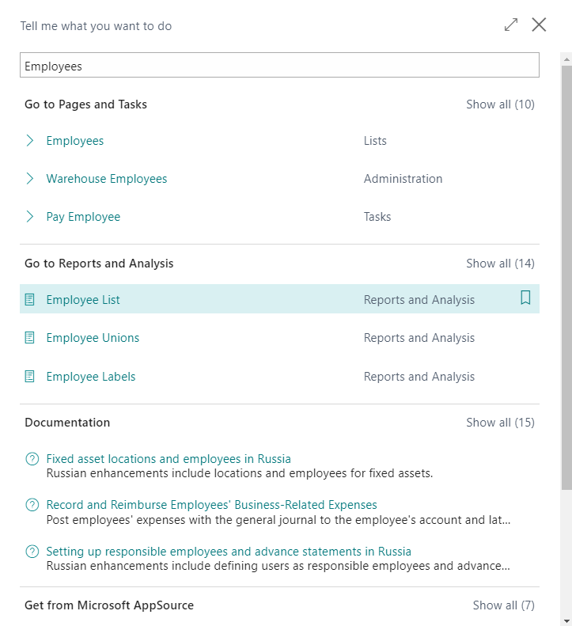
Enable Users to Search for a Page
Set the UsageCategory property on the page level to make it searchable.
UsageCategory property can have one of the following page types:
Administration
Documents
History
Lists
None
ReportsAndAnalysis
Tasks

Slide 11
Page, Fields, and Action Triggers
Page Triggers:
OnInit - Use when the page is loaded but before the controls are available.
OnOpenPage - Use when the page is initialized and the controls are available.
OnAfterGetRecord - Use when a record has been retrieved but not yet displayed.
OnAfterGetCurrRecord - Use after the current record is retrieved from the table.
Page Field Triggers:
OnAssistEdit - Triggered when someone uses the Assist Edit button.
OnDrillDown - Triggered when a user selects a control that acts as a drill-down control.
OnLookup - Triggered when a user selects a drop-down control that performs a lookup.
OnValidate - Triggered when a user enters a value in a field and then leaves the field.
Action trigger:
OnAction – Triggered when a user selects the button on a page.

Slide 12
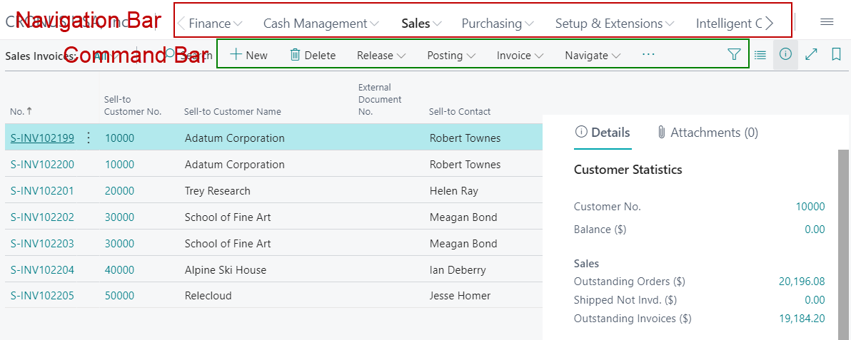
Navigation Bar and Command Bar

Slide 13
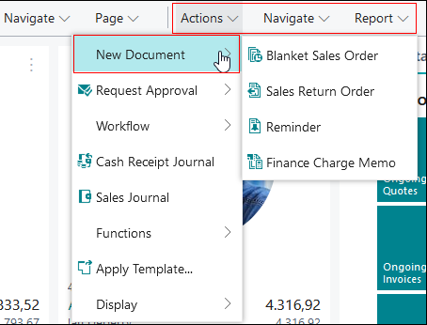
Defining Actions
The four available action areas are:
Navigation - Corresponds with the Navigate menu.
Creation - Corresponds with the New Document menu in the Actions menu.
Reporting - Corresponds with the Report menu.
Processing - Corresponds with the Process menu.

Slide 14
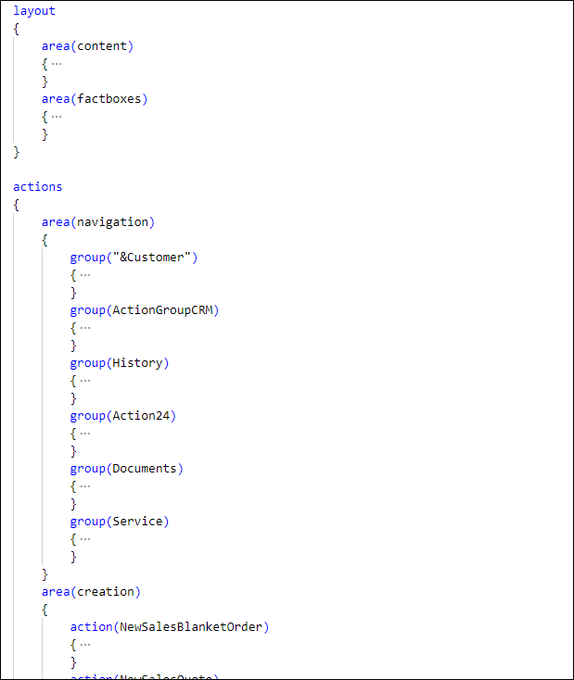
Defining actions contd.

Slide 15
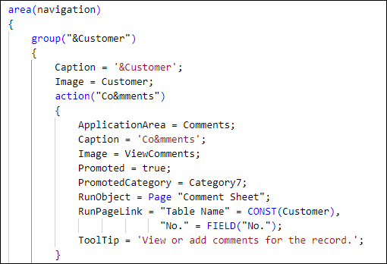
Action Properties
ID, a Name, a Caption, and an Image property
Promoted, PromotedIsBig, PromotedOnly, and PromotedCategory properties
RunObject, RunPageView, and RunPageLink properties
Notes:
Just like tables, fields, pages, and controls, the actions on a page also have some properties. All actions have an ID, a Name, a Caption, and an Image property. The Image property is used to display an image in the action.
Promoted, PromotedIsBig, PromotedOnly, and PromotedCategory properties
The Promoted property is used to push the action in the first part of the command bar, before the separator. The promoted actions should always be promoted in a certain category. Therefore, you must set the PromotedCategory property. A PromotedCategory will result in a menu being displayed that contains the action.
The PromotedCategory has fixed values. You can choose between New, Process, Report, and Category4 through Category20. Certainly, you don't want the name of the menu showing as Category5. Therefore, you need to use a page property called PromotedActionCategories.
In the next example, the action with the name Comments is promoted in Category7, meaning that it will be displayed in a Customer menu.
If you only want to have your action promoted and don't want it showing up in one of the normal menus (Actions, Navigate, Report, New Documents), then you can use PromotedOnly, which is a Boolean property.
The PromotedIsBig property is used to change the order of the displayed actions. With PromotedIsBig, the action will appear before other actions.
When you want to open a page or run code when a user selects an action, you can write AL code in the OnAction trigger. You can also use the RunObject property.
With the RunObject property, you can run the following objects:
Page
Report
XMLPort
Codeunit
The RunPageLink, RunPageMode, and RunPageView properties are all related to pages, so you'll use them if you run a page.
The RunPageLink is used to create a connection between two source tables of two pages. For example, if you want to view all sales orders for a specific customer from an action on the Customer Card, you need to link the customer with the sales orders. As a result, the Sales Orders page will be filtered on the selected customer. You can also set extra filtering.
The RunPageMode indicates in which mode that the page you are running should open. It can be opened in a View, Edit, or Create mode. However, if you configured your page and its InsertAllowed property is set to No, running your page in Create mode won't work.
The RunPageView property allows you to put a table filter on your page and to have a filtered result.

Slide 16
Getting Started with Page Extensions
The layout section has nine keywords for extension:
addfirst(anchor)
addlast(anchor)
addafter(anchor)
addbefore(anchor)
modify(name)
movefirst(anchor; controls)
movelast(anchor; controls)
moveafter(anchor; controls)
movebefore(anchor; controls)

Slide 17
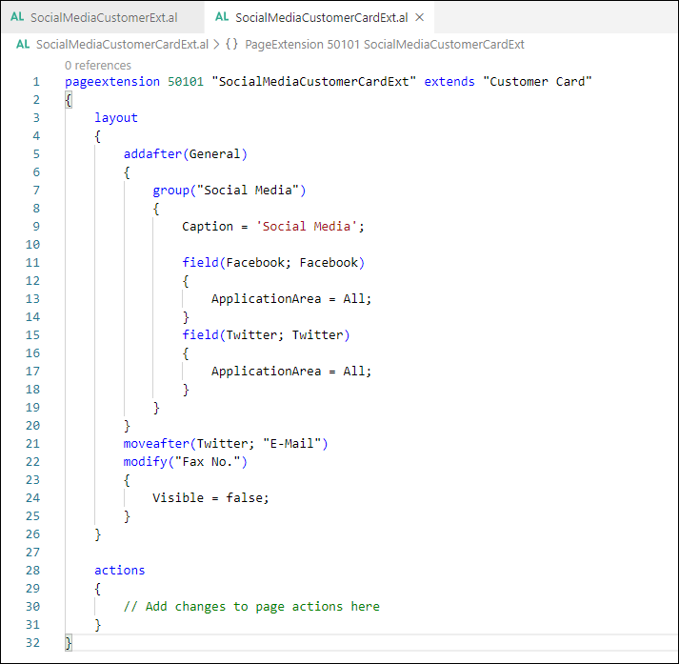
Getting started with page extensions continuation

Slide 18
Page Properties That can be Changed in Extension
Page Properties | Field Properties |  | Action or Action Group Properties
AdditionalSearchTerms Caption DataCaptionExpression Description Editable InstructionalText PromotedActionCategories | ApplicationArea AssistEdit BlankZero Caption CaptionClass ClosingDates Description Enabled Editable Visible | Width HideValue Importance ShowCaption ShowMandatory QuickEntry ToolTip Style StyleExpr | Caption Tooltip Description Enabled Visible ApplicationArea Promoted PromotedIsBig PromotedOnly PromotedCategory ShortcutKey

